Slide 1
Enhancing Security using Digital Image Processing

Slide 2
ABSTRACT
The problem of enhancing security of a secret image and secret message, which is to be sent over a network, by digitally processing it. We require that the secret image and secret message to be sent to the recipient in such a way that no one else suspects the existence of them. A cover image is used as a decoy in this technique in which the secret image as well as the secret message are embedded. Thus, the receiver obtains the secret image and the secret message from the cover image.

Slide 3
CONTENTS
PROBLEM STATEMENT
INTRODUCTION
WHAT IS STEGANOGRAPHY
WHAT IS IMAGE STEGANOGRAPHY
DIFFERENCE BETWEEN STEGANOGRAPHY,CRYPTOGRAPHY,WATERMARKING
WORKING
AES ALGORITHM APPROACH
STEPS INVOLVED IN IMAGE ENHANCING
WORK FLOW
APPLICATIONS
ADVANATAGES OVER CRYPTOGRAPHY
CONCLUSION
FUTURE SCOPE

Slide 4
PROBLEM STATEMENT
We know that email service providers sell our data to third party companies for their usage and profits.
In today’s scenario, security is a major concern while transmitting any information over the network.
Security provided by the network is insufficient with the increasing rates of cybercrimes. Therefore, we need employ other techniques to carefully send our data over the network.
In this project, we explore a number of security techniques that can be combined together to ensure higher levels of security to our data.

Slide 5
INTRODUCTION
In today’s world of growing technology security is of atmost concern. With the increase in cyber crime, providing only network security is not sufficient.
Security provided to images like blue print of company projects , secret images of concern to the army or of company’s interest, using image steganography and stitching is beneficial.
As the text message is encrypted using AES algorithm and embedded in a part of the image the text message is difficult to find. More over since the secret image is broken down into parts and then sent to the receiver. This makes it difficult for the trespassers to get access to all the parts of the images at once.
Thus increasing the security to a much needed higher level. This makes it becomes highly difficult for the intruder to detect and decode the document.

Slide 6
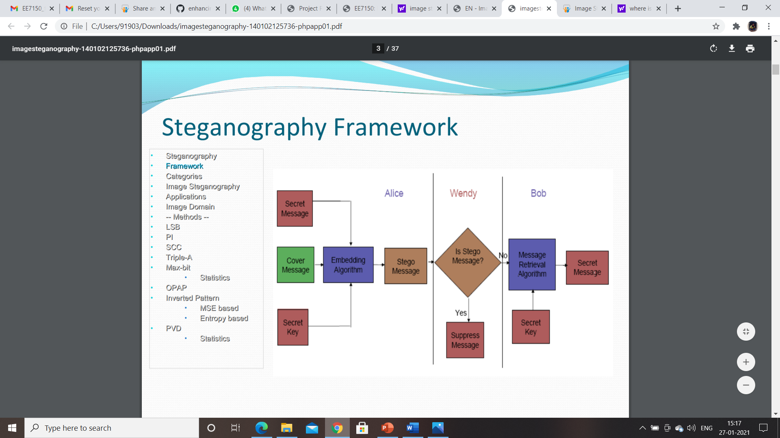
WHAT IS STEGANOGRAPHY ?
Steganography is the art and science of writing hidden messages in such a way that no one, apart from the sender and intended recipient, suspects the existence of the message.

Slide 7
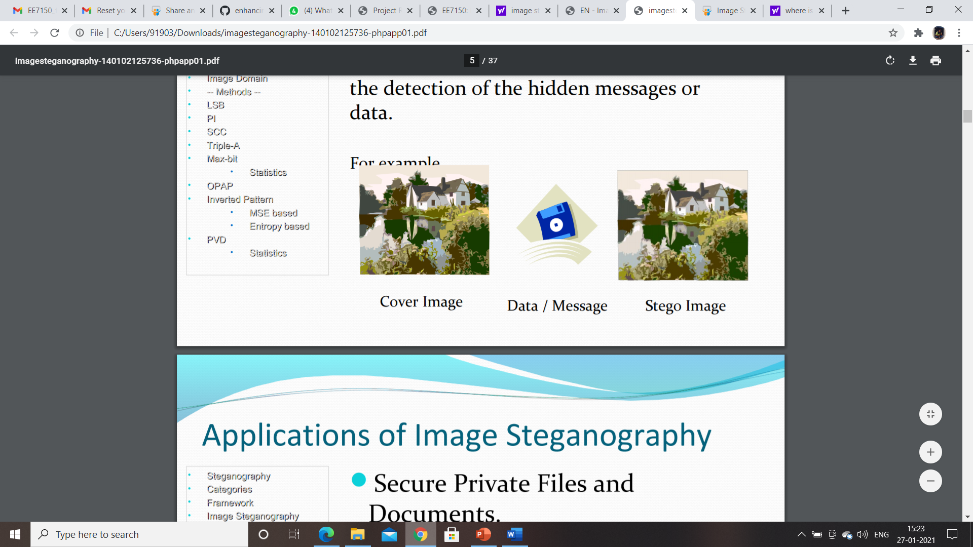
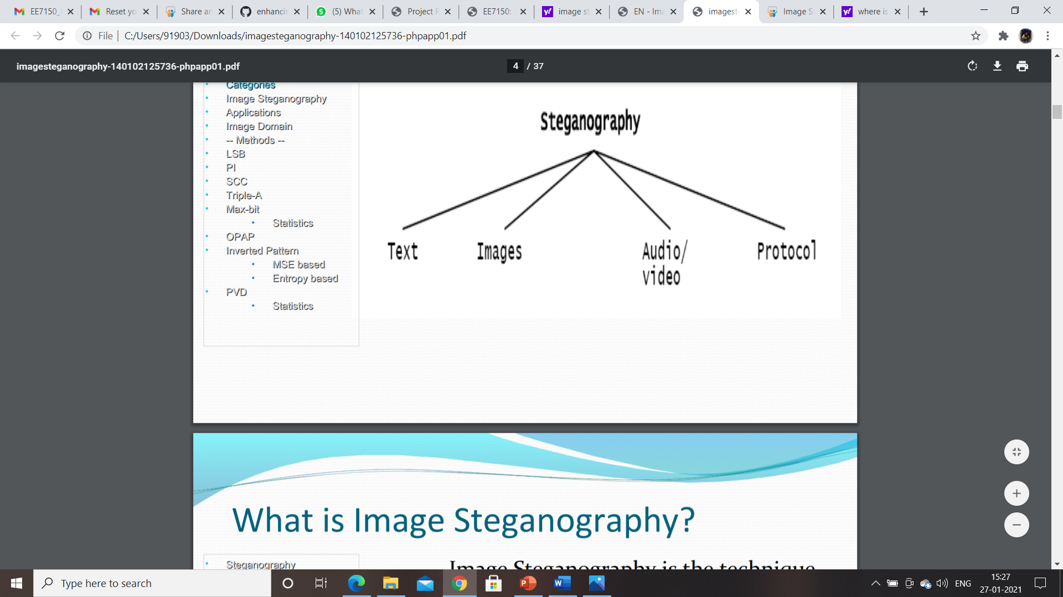
WHAT IS IMAGE STEGANOGRAPHY?
Image Steganography is the technique of hiding the data within the image in such a way that prevents the unintended user from the detection of the hidden messages or data.

Slide 8
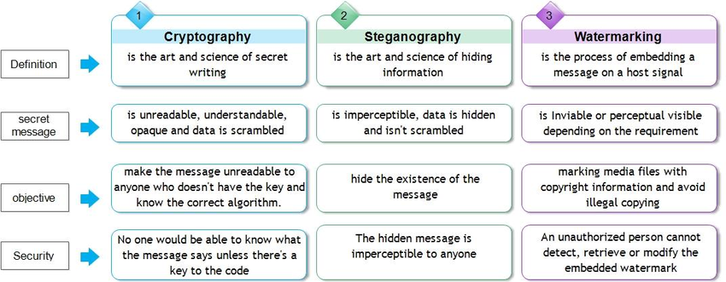
DIFFERENCE BETWEEN CRYPTOGRAPY, STEGANOGRAPHY,WATERMARKING :

Slide 9
WORKING
The secret message is encrypted using AES algorithm while the secret image is normally hidden using LSB based image steganography.
This makes things easier for a malicious third party user to use methods such as brute force to extract the secret image from the stego image during the transmission of the image over a communication network.
Hence, in our implementation, we encrypted the secret image using AES algorithm and hid the secret text using LSB based image steganography in this encrypted image.
The paper proposes using Panorama Image Stitching to stitch the images sent in parts. This requires all image blocks to have overlapping content.
Stitching the images using panoramic stitching would result in an image which has its constituent bits modified, thus leading to loss in information in terms of the secret image as well as the secret message.

Slide 10
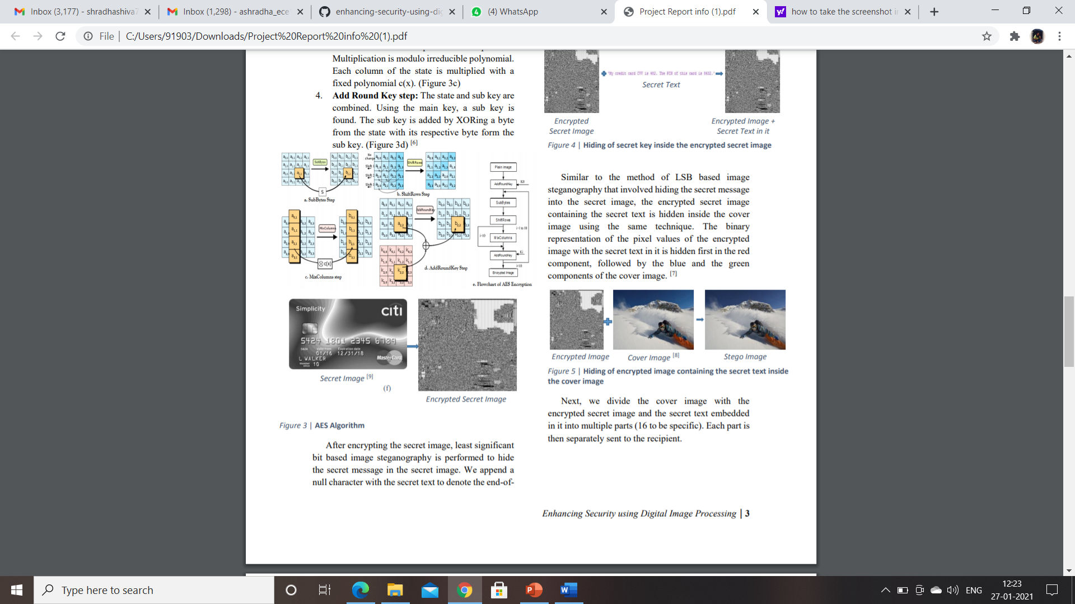
AES ALGORITHM APPROACH
Image encryption and decryption was implemented using the AES algorithm.
Firstly, the given image was resized to a known size (480 x 480). Then the image was divided into Nx16 blocks.
The sender and receiver use a key of 128 bits. This key must be shared between the sender and the receiver in a secure manner.
The key can be imagined as blocks x[0],x[1]...x[15], where each block is 8 bits long. [4]
The AES algorithm uses a round function that is composed of four different byte related transformations:
SubBytes step
Shift Rows step
Mix Columns step
Add Round Key step

Slide 11
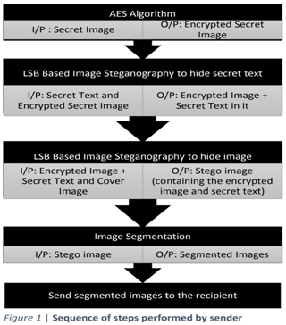
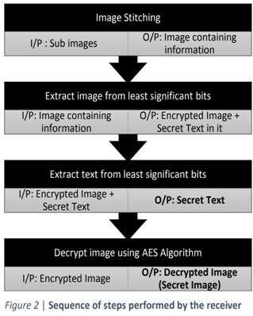
STEPS INCLUDED IN IMAGE ENHANCING

Slide 12

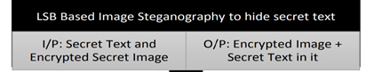
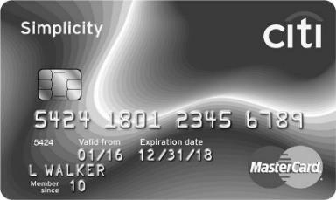



WORK FLOW
SENDER
1.
2.
Secret Text
Secret image
*Secret text is My credit card CVV is 482. The PIN of this card is 8632.
Encrypted secret image

Slide 13
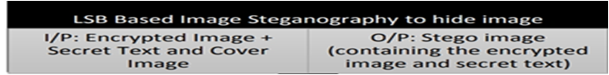


3.
Encrypted Image
Cover Image
Stego Image
Hiding of encrypted image containing the secret text inside the cover image

Slide 14

4.

Slide 15
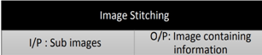
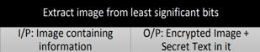
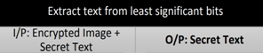
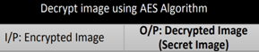
RECEIVER
Secret text is My credit card CVV is 482. The PIN of this card is 8632.

Slide 16
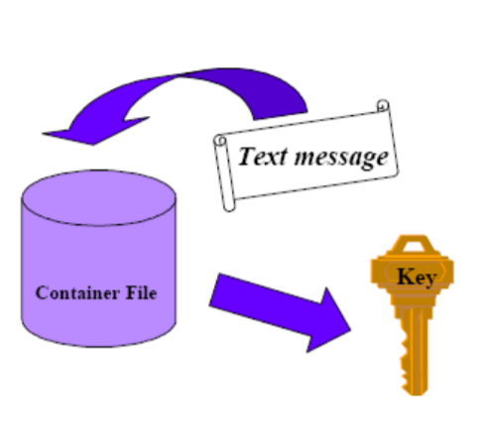
Applications :
Secure Private Files and Documents.
Hide Passwords and Encryption Keys.
Transport Highly Private Documents between International Governments.
Transmit message/data without revealing the existence of available message.
It is a state-of-the-art digital steganography software package developed for confidential multimedia communication.
The software allows the user to select a multimedia data file or "container" for embedding hidden text, audio sequence, video clip, or any form of data file.

Slide 17
ADVANTAGES OF STEGANOGRAPHY OVER CRYPTOGRAPHY:
The advantage of steganography, over cryptography alone, is that messages do not attract attention to themselves.
whereas cryptography protects the contents of a message, steganography can be said to protect both messages and communicating parties.
In Electronic Communication may include steganographic coding inside the transparent layer ,such as document file ,wave file,image file.

Slide 18
CONCLUSION
Steganography can protect data by hiding it but using it alone may not guarantee total protection.
In case of encryption, by seeing the meaningless appearing sequence of bits enemy can detect that some illegal message is being sent.
However, if one uses both methods, this will lead to ‘security in depth’.
The message should first be encoded using a strong encryption algorithm and then embedded into a carrier.

Slide 19
FUTURE SCOPE
In the near future, the most important use of steganographic techniques will probably be lying in the field of digital watermarking
The possible use of steganography technique is as following:
Hiding data on the network in case of a breach.
Peer-to-peer private communications.
Posting secret communications on the Web to avoid transmission.
Embedding corrective audio or image data in case corrosion occurs from a poor connection or transmission.

Slide 20
THANK YOU

